Slide 1
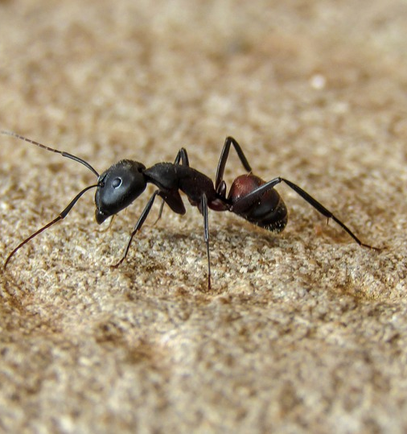

Back to home in desert
Overview
Paper of M. Collett
Concept of global and local vector
Model of the ant
Conducted experiments
Our simulation
Conclusion
Source: https://www.antbites.net/adult-ants-fourth-stage-of-the-ant-life-cycle/

Slide 2
Paper of M. Collett et al.
Written in 1998
Navigation of desert ants
M. Collett, T. S. Collett, S. Bisch, R. Wehner

Slide 3

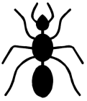
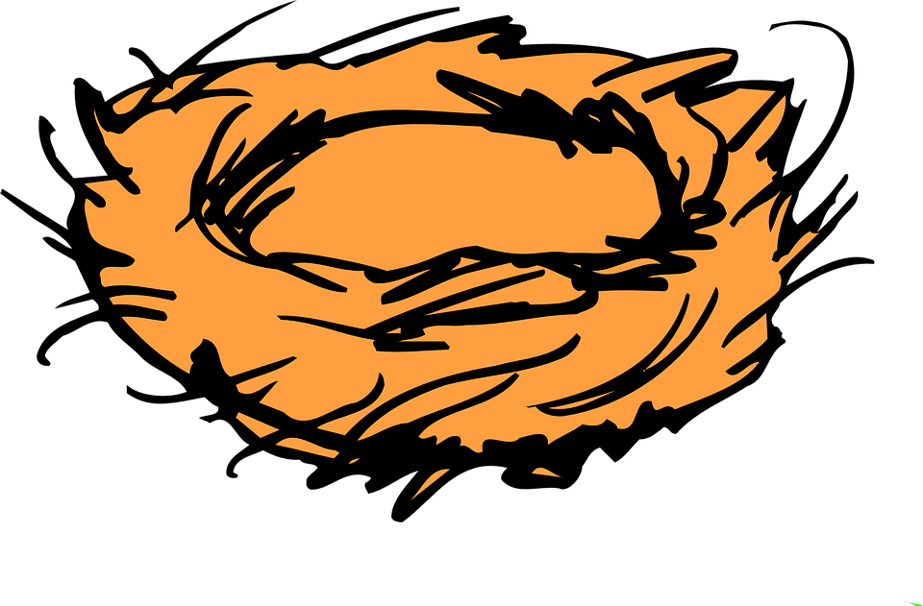
Global and local vector
Problem: few visible landmarks in desert
Solution: path integration => global vector
Sun as compass
Landmarks => local vector
Relative to cardinal direction
Interesting, because sun is needed
Images source: https://pixabay.com

Slide 4
Model of the ant
Python
Iterative approach
Global and local vector calculated in every step
Global vector
Each step added
Randomization
Local vector
Landmarks «pull» ants
The closer the stronger
global vector
current step

Slide 5
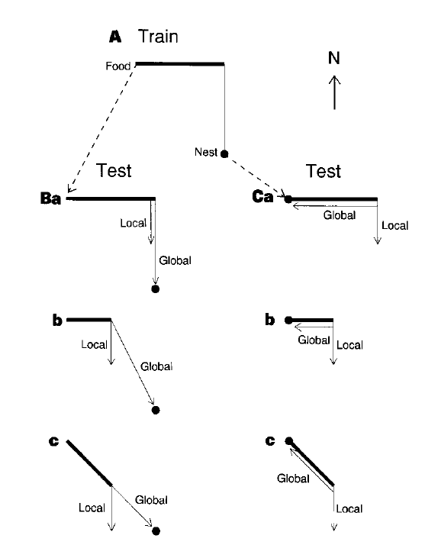
Conducted experiments by M. Collet et al.
The desert ants were trained on setup A
They were picked up at next or feeder
Launching position is always the feeder
Test B: pickup feeder – launching feeder
Test C: pickup nest – launching feeder

Slide 6
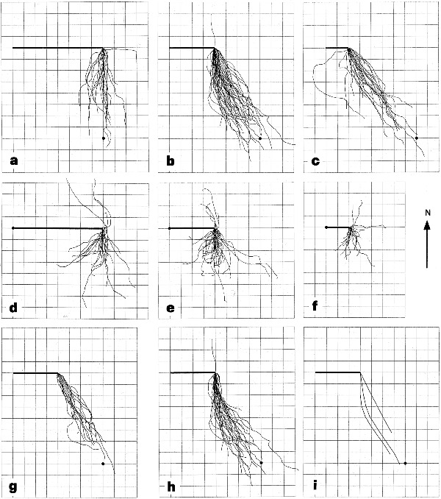
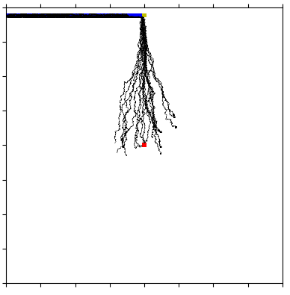
Results Test Ba
feeder
channel
nest

Slide 7
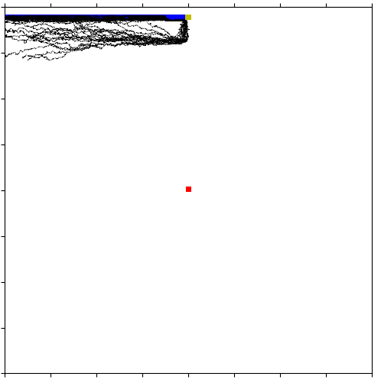
Results test Bc
feeder
channel
nest

Slide 8
Results test Bc
feeder
local vector
global vector
Josua Graf, Noah Zarro

Slide 9
Second experiment setup
Black cylinders as visible landmarks
Ants training: walking from the feeder to the nest
Test 2a: exactly the same as training
Test 2b: pick up the ants at nest and launching at feeder

Slide 10
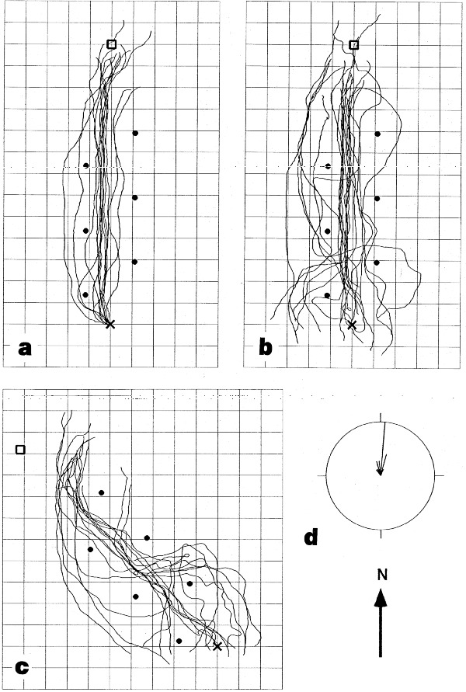
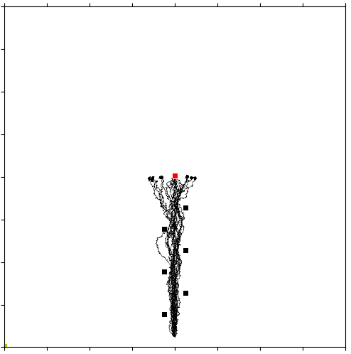
Results test 2a
nest
feeder

Slide 11
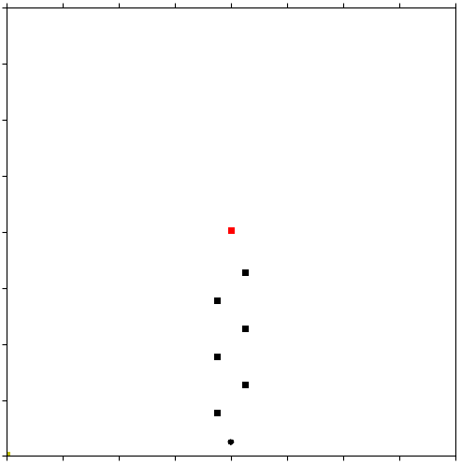
Result test 2b
nest
feeder

Slide 12
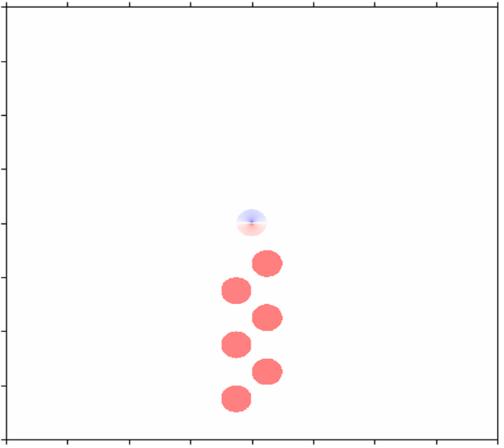
Only local vector
nest
feeder
Josua Graf, Noah Zarro

Slide 13
Conclusion
Between the experiments and the simulation exist visible similarities
Biggest difference: search walk of disoriented ants

Slide 14
Possible improvements
Implementation of a search walk
Concept for natural exceptions
Social interactions between desert ants

